Slide 1





Project Title :
Smart Agro – Intelligent IoT & AI Farming System
Team ID - CU_CP_Team_14061
Team Leader Name – Shabbir Shaikh
Team Member 1 – Samarth Parmar
Team Member 2 – Patel HetKumar
Team Member 4 –Hevil
Team Member 3 – Kavya Trivedi
Under the mentorship of,
Hiren Modha
Notes:
Slide Duration: 5 min
Objective: To get an insight about Design Thinking
Procedure:
Explanation:
Introduce the topic "Design Thinking"
Design thinking is a creative approach to problem-solving that puts people at the center.
It starts with understanding the needs of those who will use what you're designing.
Then, it involves brainstorming ideas, prototyping solutions, and testing them to see what works best.
It's about being open-minded, collaborative, and willing to try new things to come up with innovative solutions that really fit people's needs.
Learning outcome: Students will be introduced to the topic Design Thinking.

Slide 2
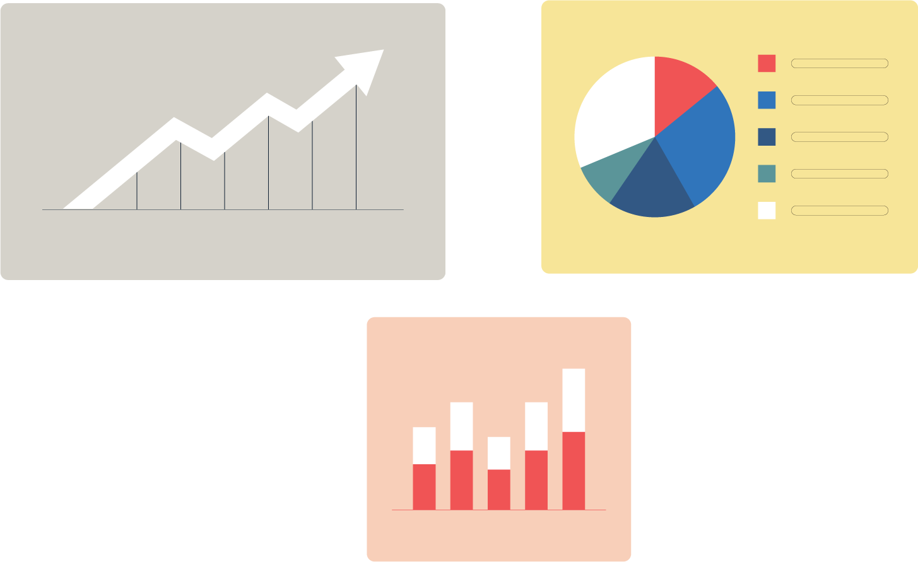


Project Objectives
Problem Statement
Project Overview – Introduction
End Users
Wow Factor in Project
Modelling/Block Diagram/Flow of Project
Result/outcomes
Conclusion
Future Perspective
Notes:
Slide duration: 5 min
Objective: To know the content of the lesson.
Procedure:
Tell students what they are going to learn today.
Discuss each topics given in the slide.
Learning Outcome: Students will get to know the content of today's lesson.

Slide 3

Problem Statement
Modern farmers often lack real-time, actionable data regarding soil conditions, climate, and crop health. This leads to inefficient resource usage (like over-watering or under-watering) and delayed responses to crop diseases, ultimately reducing crop yield and profitability.
Notes:
Total duration: 5mins
Learning Objective: In this slide, the trainer will explain the students what they will learn and be able to apply in the real life situations.
Procedure: Discuss the above as the outcome of the session
Learning outcome: Students will understand the learning outcome in this slide.

Slide 4
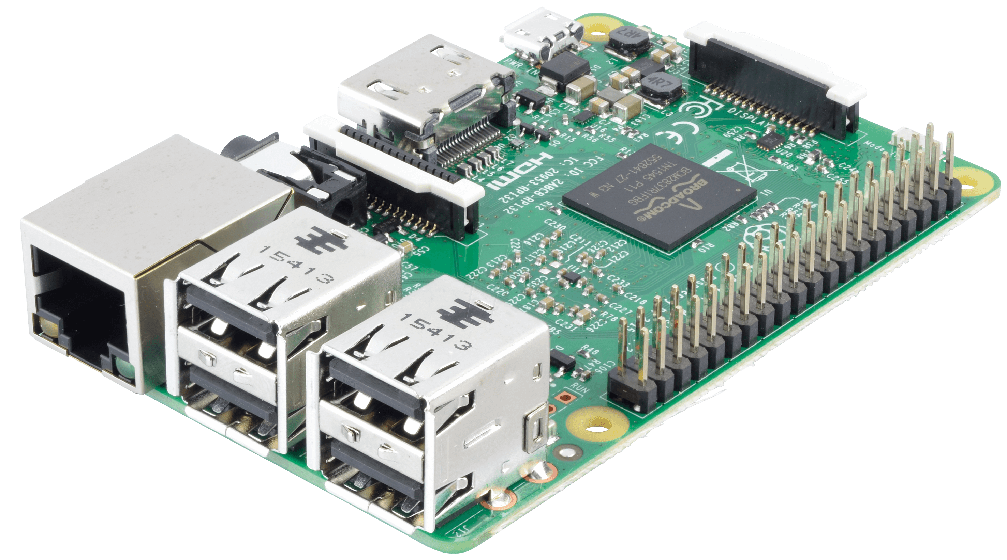
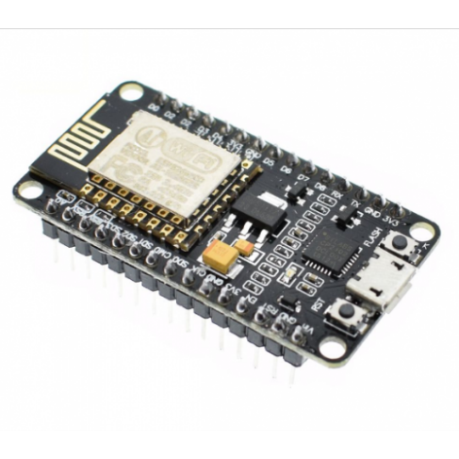
Project overview - Introduction
The Solution: Smart Agro is a fully integrated hardware and software platform designed to modernize agriculture.
How it Works: We use ESP32 microcontrollers and field sensors to collect live environmental data. This data passes through a local Raspberry Pi gateway to a powerful Python backend. From there, Artificial Intelligence analyzes the data to predict irrigation needs and diagnose plant diseases, displaying everything on a live web dashboard.
Notes:
Total duration: 5mins
Learning Objective: In this slide, the trainer will explain the students what they will learn and be able to apply in the real life situations.
Procedure: Discuss the above as the outcome of the session
Learning outcome: Students will understand the learning outcome in this slide.

Slide 5
End User
Smart Greenhouse Operators 🪴
Tracking precise micro-climates and AI driven irrigation needs for highly controlled agricultural environments
Agricultural extensions officers 📋
Utilizing remote AI health scores and historical data to provide expert, data driven farming recommendations
Local & Commercial Farmers 🧑‍🌾
Empowering daily operations with real-time soil monitoring and instant crop disease diagnosis to maximize yield.
Notes:
Total duration: 5mins
Learning Objective: In this slide, the trainer will explain the students what they will learn and be able to apply in the real life situations.
Procedure: Discuss the above as the outcome of the session
Learning outcome: Students will understand the learning outcome in this slide.

Slide 6

Wow factor
Real-Time Live Updates: Unlike standard apps that require you to refresh the page, our React dashboard uses WebSockets (Socket.IO) to stream sensor data to the screen the exact second it changes in the field.
Deep Learning Computer Vision: Our backend doesn't just show numbers; it uses a custom deep learning AI model to analyze uploaded leaf images, instantly detecting up to 50 different classes of plant diseases and providing specific treatment plans.
Notes:
Total duration: 5mins
Learning Objective: In this slide, the trainer will explain the students what they will learn and be able to apply in the real life situations.
Procedure: Discuss the above as the outcome of the session
Learning outcome: Students will understand the learning outcome in this slide.

Slide 7
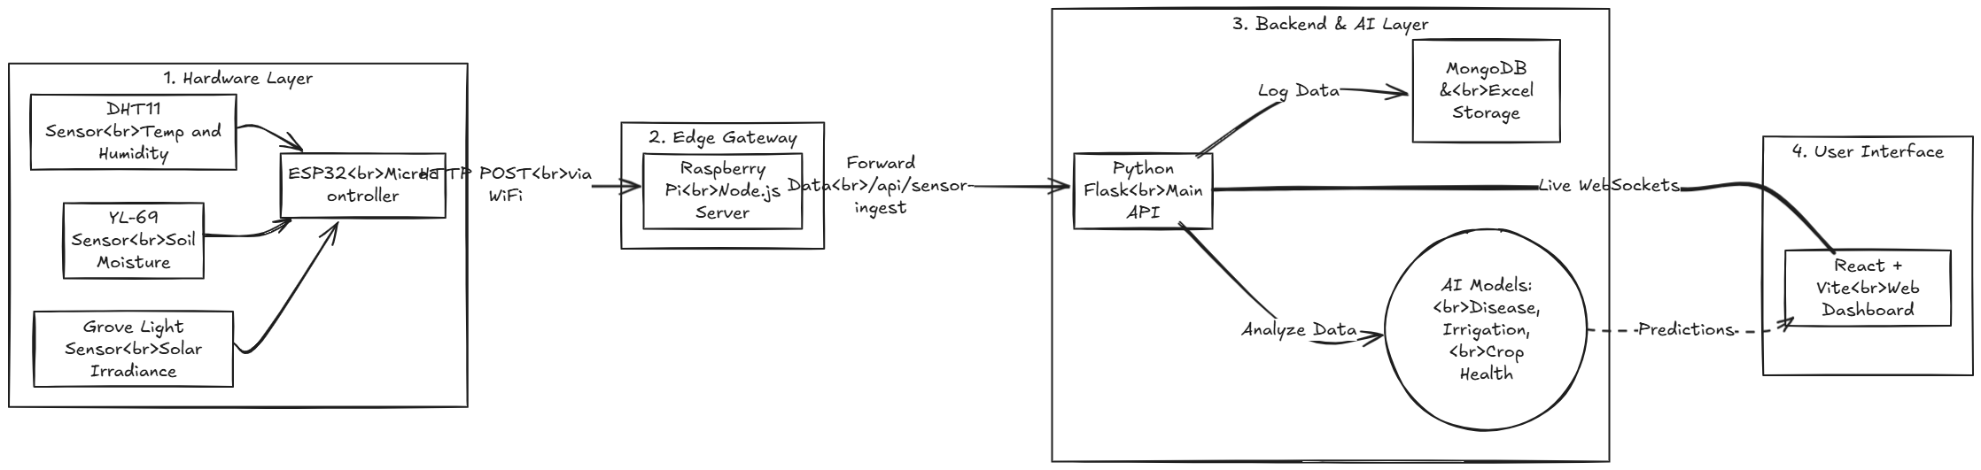
Flowchart :
Notes:
Total duration: 5mins
Learning Objective: In this slide, the trainer will explain the students what they will learn and be able to apply in the real life situations.
Procedure: Discuss the above as the outcome of the session
Learning outcome: Students will understand the learning outcome in this slide.

Slide 8
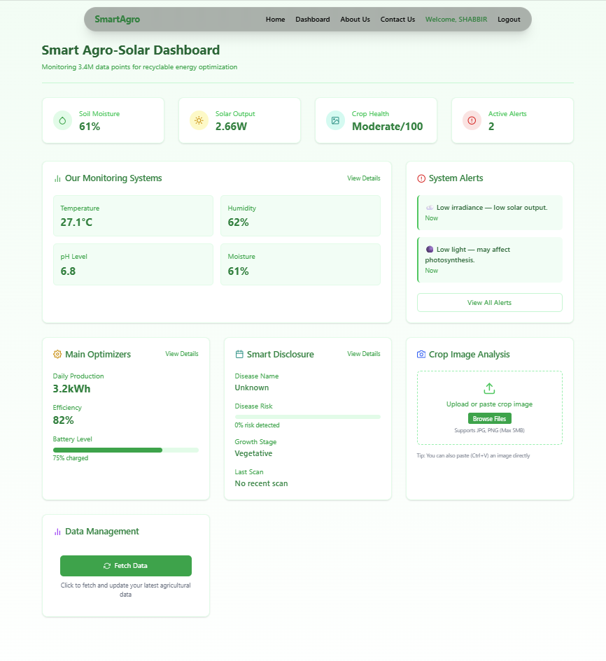
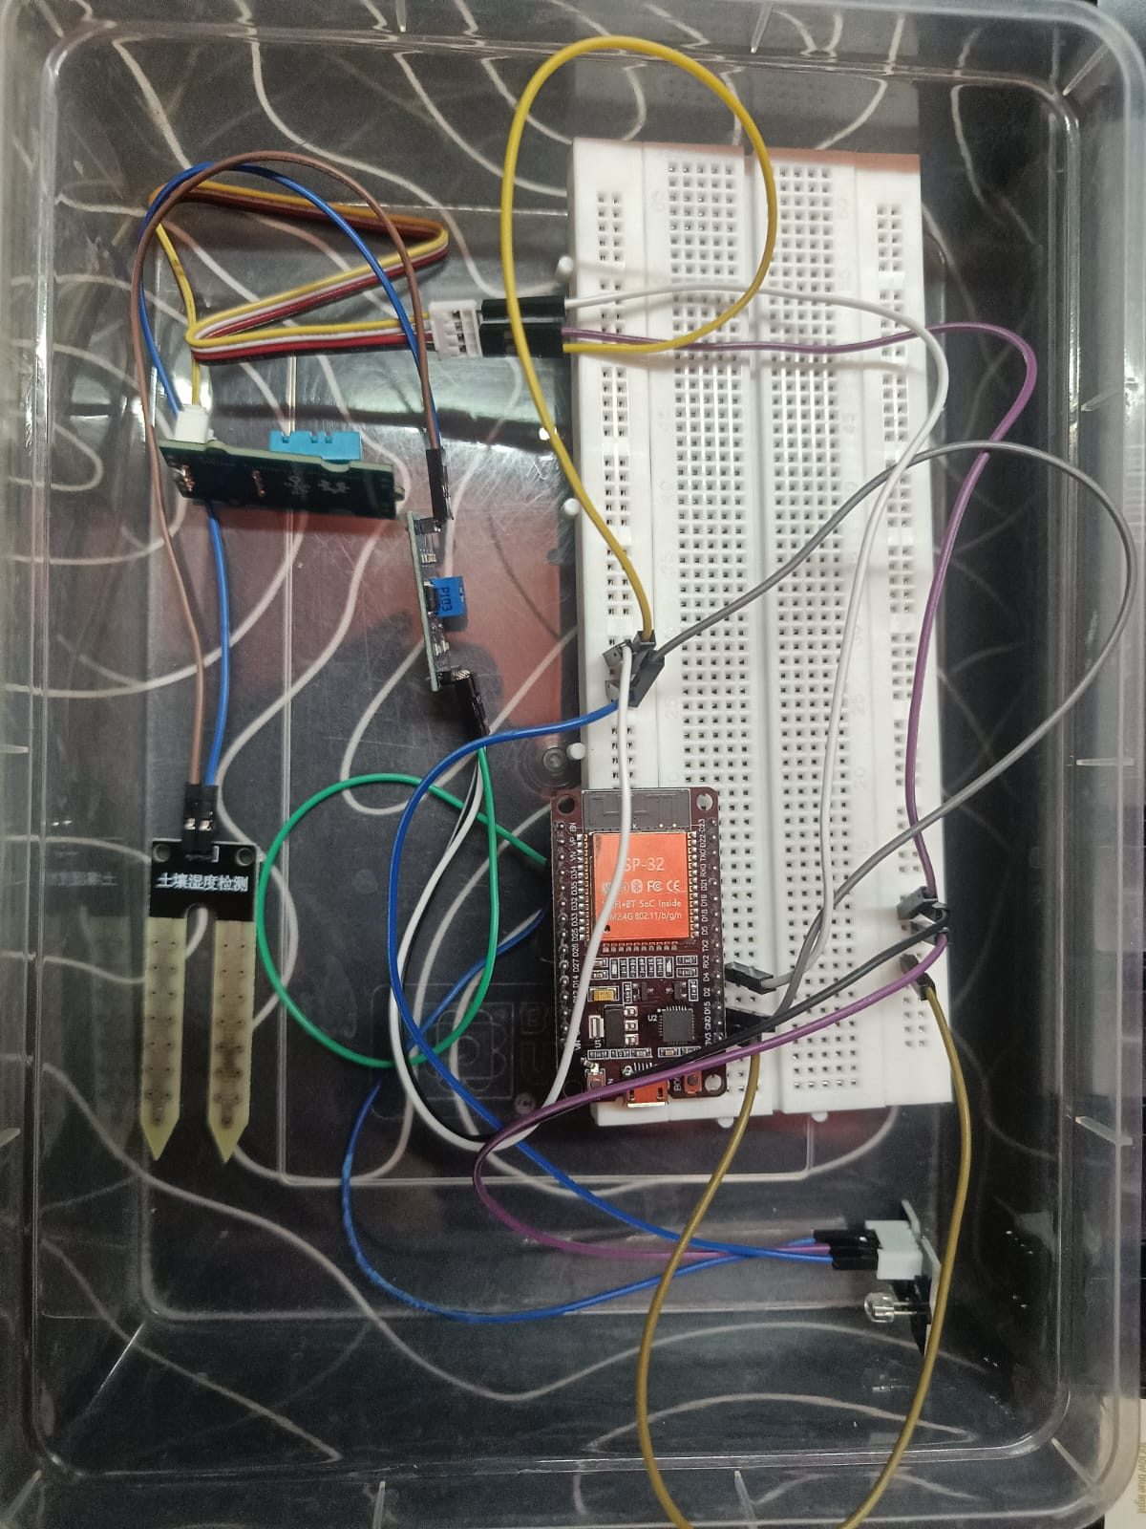
Result / Outcomes
Functional Prototype
Successfully built an end-to-end IoT pipeline that reads analog field data and transmits it to a cloud-ready server without data loss.
AI Integration:
Successfully deployed Scikit-Learn and Keras models that can accurately predict when a crop needs irrigation, estimate solar output, and calculate an overall crop health score.
Notes:
Total duration: 5mins
Learning Objective: In this slide, the trainer will explain the students what they will learn and be able to apply in the real life situations.
Procedure: Discuss the above as the outcome of the session
Learning outcome: Students will understand the learning outcome in this slide.

Slide 9

Conclusion
Smart Agro successfully bridges the gap between raw hardware sensors and advanced Artificial Intelligence. By giving farmers a low-cost, real-time, and intelligent tool, we are taking a massive step toward sustainable, data-driven agriculture.
Notes:
Slide duration: 5 min
Objective: To get clarity about the lesson is well received among students.
Procedure:
Ask: What did you learn from the lesson?
What is your takeaways from the lesson?
How this lesson is going to help you in your personal and professional life.
How are you going to implement this lesson?

Slide 10

Future Perspective
Protocol Upgrade: Migrating the IoT data transmission from HTTP to MQTT for lighter, faster, and more power-efficient communication.
Automated Actuators: Adding relay modules to the ESP32 so the AI can automatically turn on the water pumps when the soil is dry, moving from a monitoring system to a fully automated system.
Cloud Deployment: Hosting the Flask backend and MongoDB on AWS or Google Cloud for global accessibility and massive scalability.
Notes:
Total duration: 5mins
Learning Objective: In this slide, the trainer will explain the students what they will learn and be able to apply in the real life situations.
Procedure: Discuss the above as the outcome of the session
Learning outcome: Students will understand the learning outcome in this slide.

Slide 11
Thank You
Notes:
Time: 25 to 30 Sec

